Slide 1
KDD in practice and in theory
Yexi Jiang

Slide 2
Outline
Background
History
Stats
KDD: academy vs. industry
From needs to abstraction
Recommendation
Image Recognition
Text Analysis
Anomaly Detection
Conclusion

Slide 3
History
Statistics: 1800 -
Data dredging, data “fishing” : 1960s
Data Mining: 1980 –
Database Mining ~ 1985 (was HNC trademark, not used)
Knowledge Discovery in Data: 1989 –
KDD workshop in 1989
Analytics : 2006 –
Google Analytics, “Competing on Analytics” book
Data Science: 2010 –

Slide 4
Where did you apply analytics/data mining?
www.KDnuggets.com/polls/2010/analytics-data-mining-industries-applications.html

Slide 5
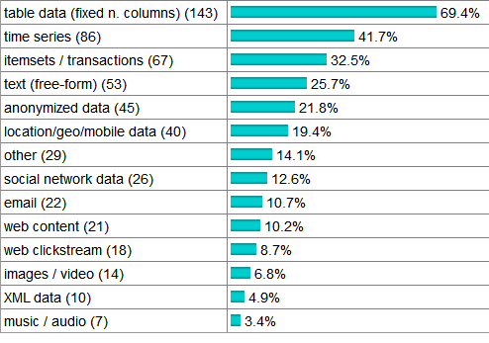
Data Types Analyzed/Mined
www.KDnuggets.com/polls/2011/data-types-analyzed-mined.html

Slide 6





















Which companies need KDD?
Social Media
Web Search
E-commerce
News
Traveling
Intelligent Devices
Finance
Sharing Economics

Slide 7
Academic versus Industry
What academic community cares about?
Precision/Accuracy
Theoretic Complexity & Bound
Problem Reduction
What industry community cares about?
Scalability: The scale a problem it can handle
Speed: The actual time complexity
The cost: The cost of the solution

Slide 8
Model versus Feature
People from academic continuously working on model improvement.
Higher precision
Better performance
More intuitive
People from industry continuously working on feature engineering.
Resolve dirty features
Resolve complex feature correlation
Allow simple model to work better

Slide 9
From needs to abstraction
Recommendation
Collaborative filtering based
Ranking based recommendation
Image recognition
Classification
Deep learning
Text analysis
Text classification
Topic modeling
Anomaly Detection
System anomaly detection
Malicious detection

Slide 10
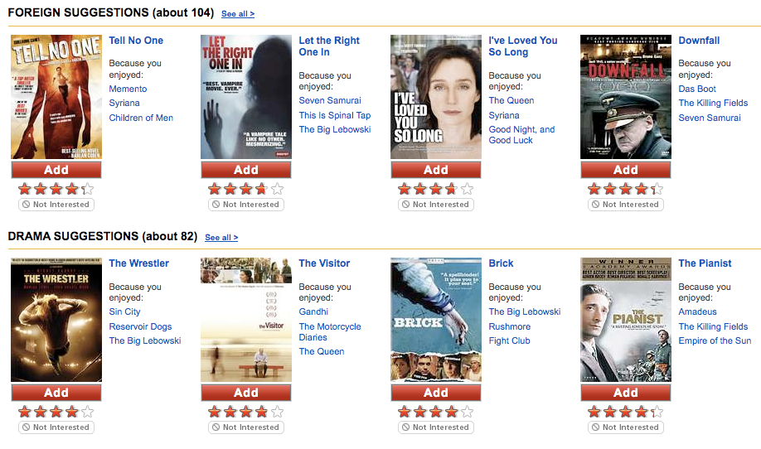

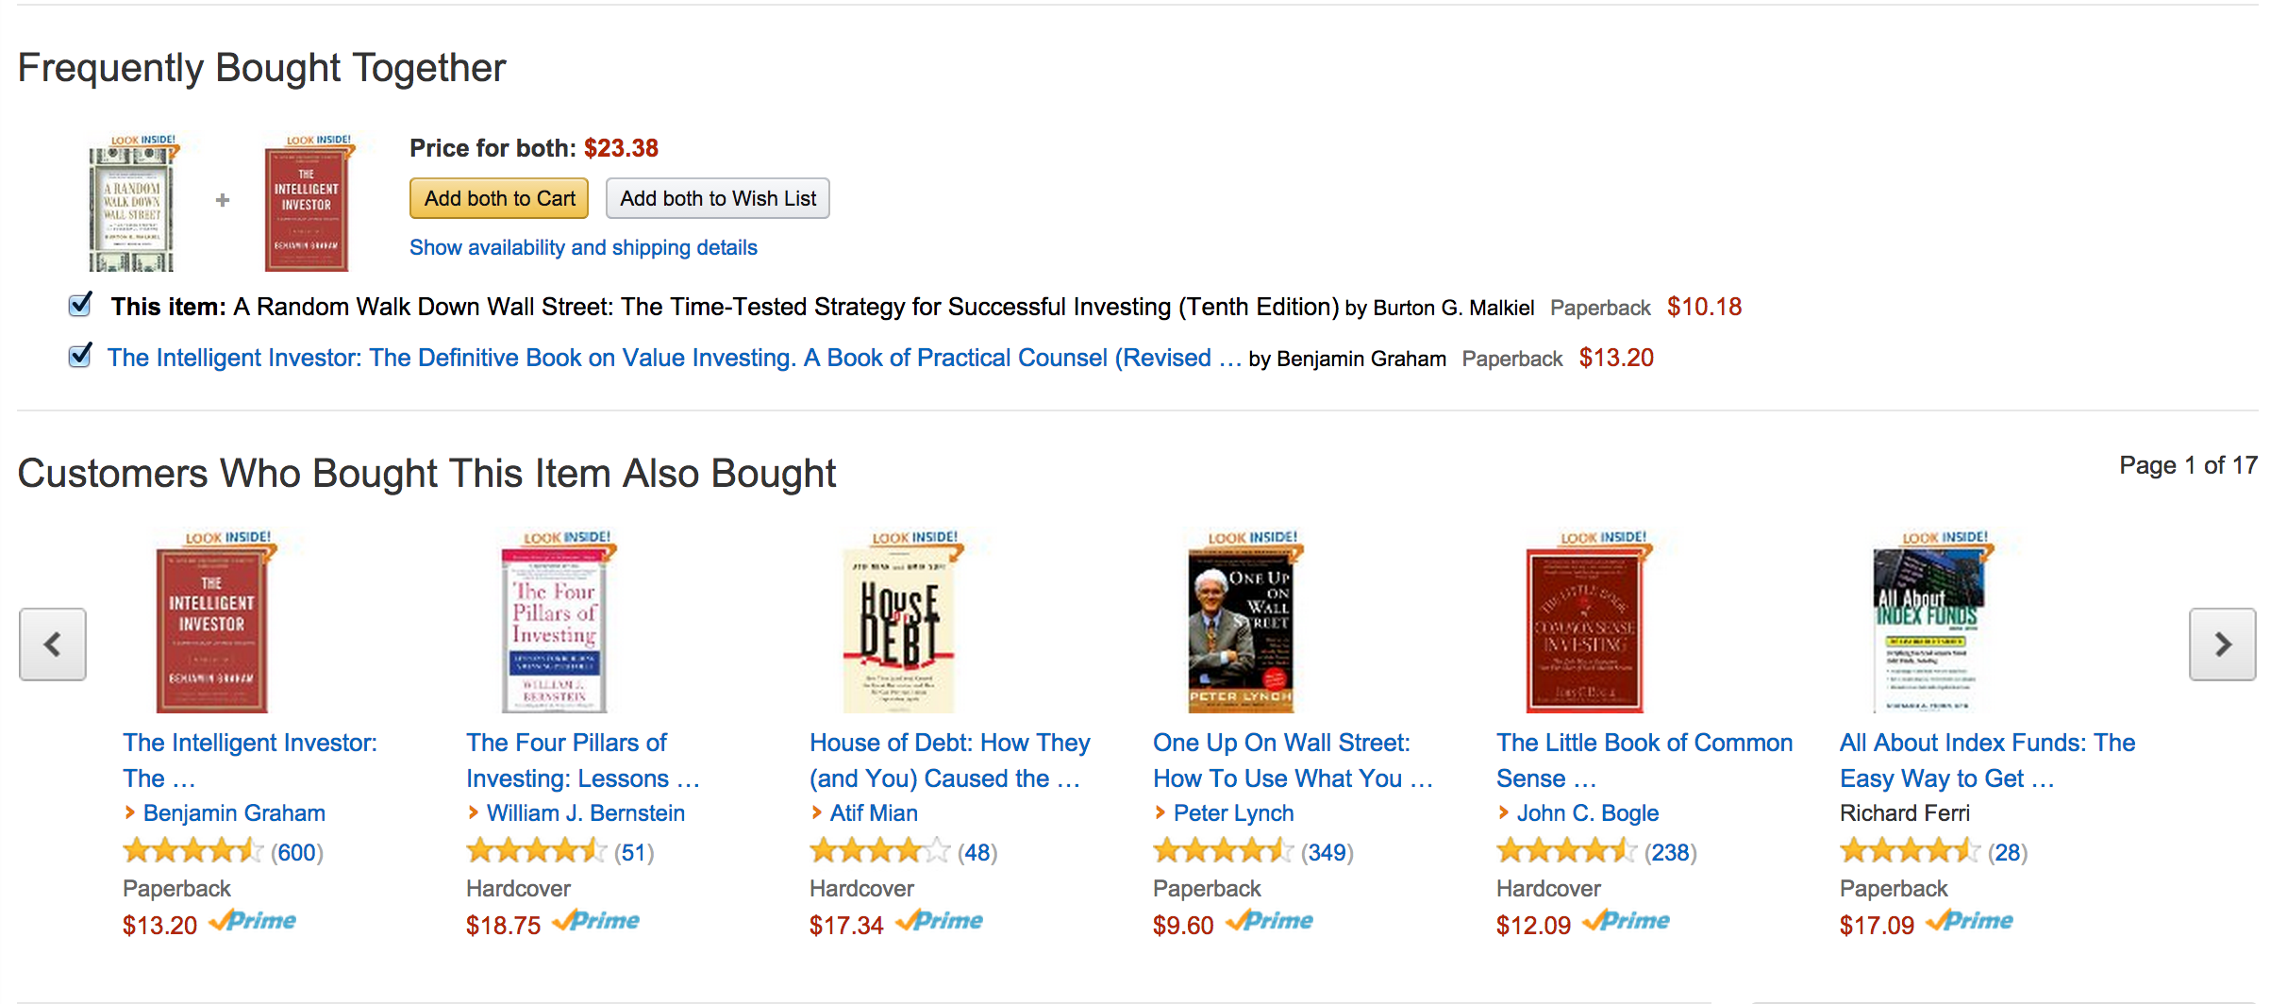
Collaborative filtering in practice
Netflix
Spotify
Amazon

Slide 11
Collaborative filtering in theory
Problem: You are interested in item X, a lot of people who are interested in X also interested in Y, so we recommend you item Y.
How to model?
Possible solutions:
Matrix completion
Matrix factorization
HUGE SPARSE MATRIX
users
Products/songs/movies etc.

Slide 12
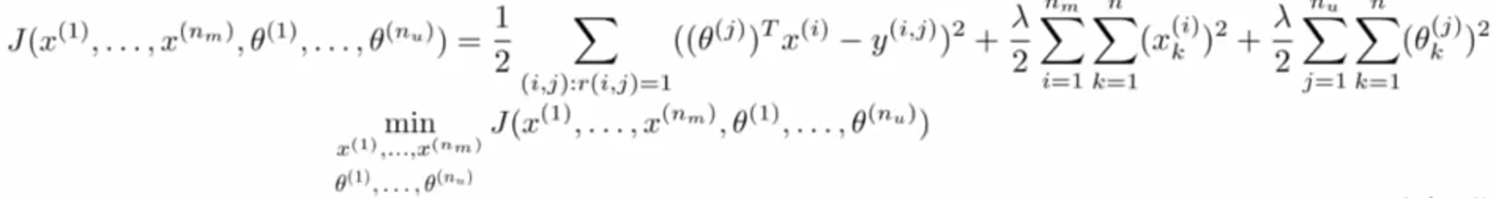
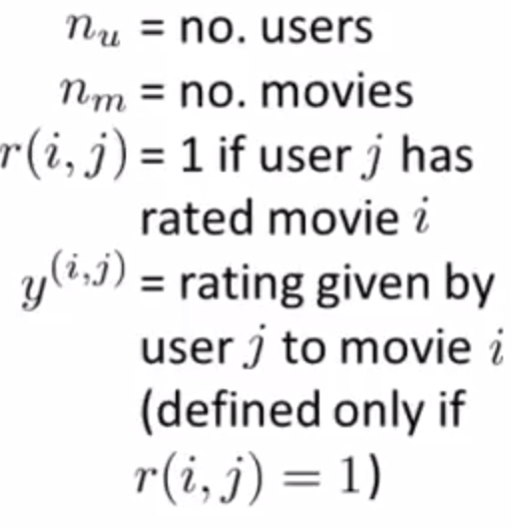
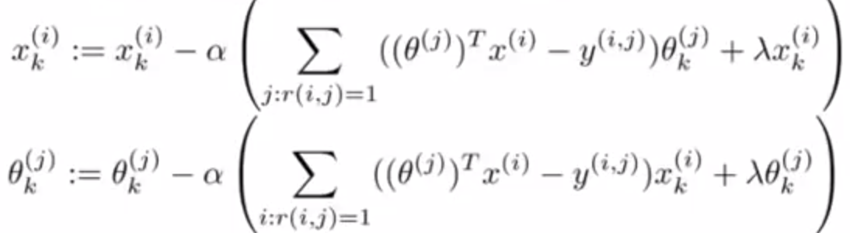
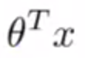
Matrix completion
Objective function:
Optimization: Gradient descent
Prediction:
Θ: user preference vector
x: movie preference vector

Slide 13
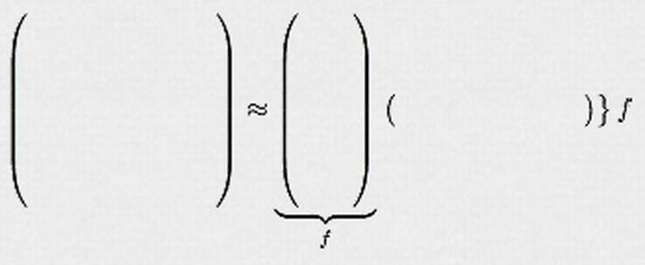
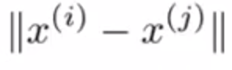
Matrix factorization
Item preference matrix
User preference matrix
If a user is interested in item i.
Recommend the user with item j where is small.

Slide 14

Ranking based recommendation in practice
Ranking based recommendation

Slide 15
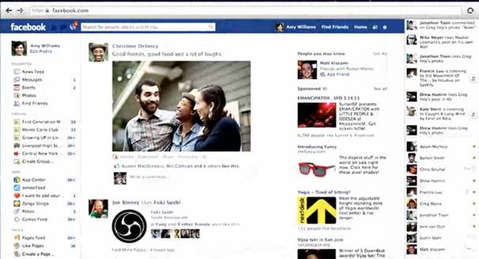
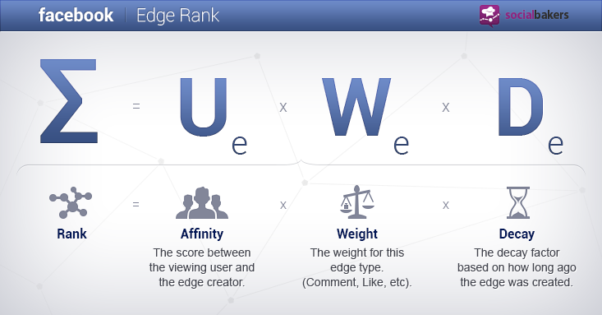
An example

Slide 16
Ranking based recommendation in theory
Estimate the probability that the user will take action p(y_{i}|x). A probabilistic 2-class classification problem.
Candidates: Logistic regression, Neural Network, SVM, KNN, etc.

Slide 17
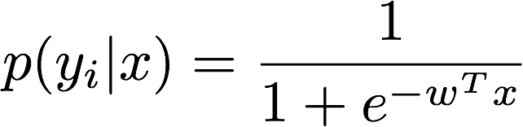
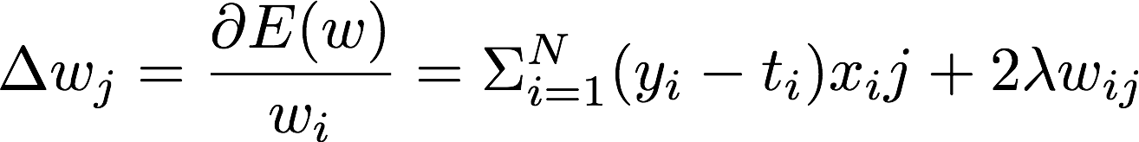
Logistic regression
Simple, fast, and enough
Model
Cost Function
Model updating

Slide 18
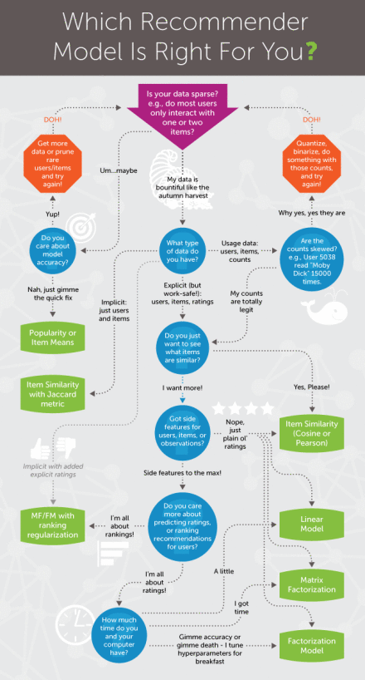

Slide 19
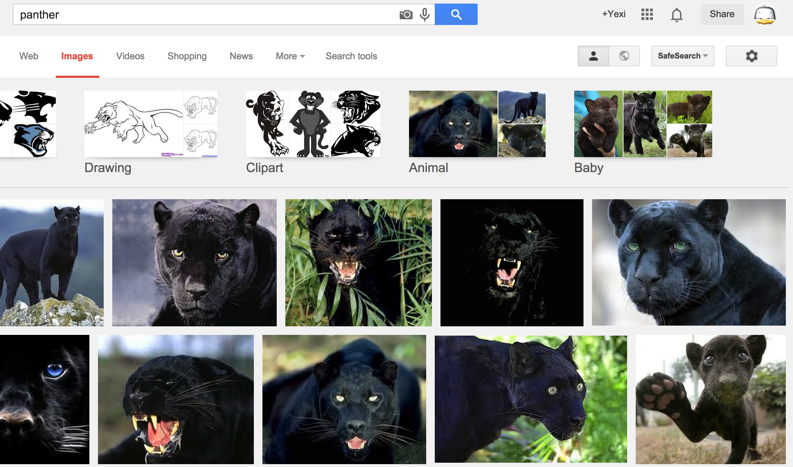
Image recognition in practice
Find ‘panther’ from Google Image Search

Slide 20

Image recognition in practice
Facebook is now really facebook

Slide 21
Image recognition in theory
Feature extraction:
sliding window, LBP (local binary pattern), SIFT (scale invariance feature transform),
Classification:
Softmax, NN, etc.

Slide 22
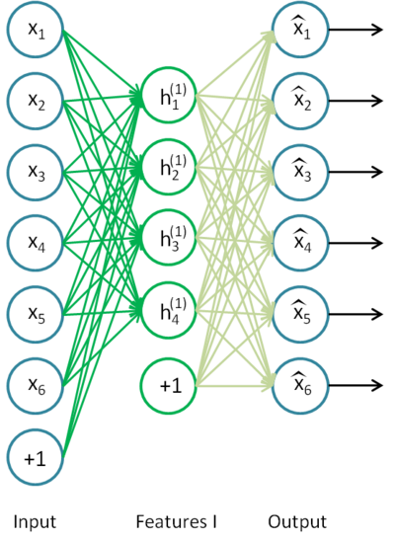
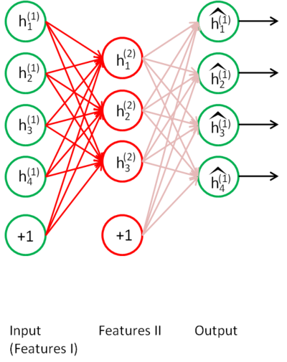
Advanced theory
Feature extraction with auto-encoder:
Stack the auto-encoders:
Extracted features from 1st auto-encoder
Copy from Stanford UFLDL

Slide 23
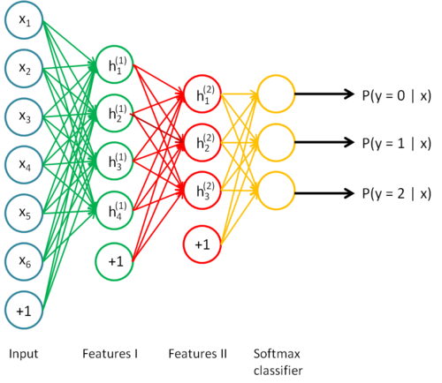
Deep learning
Input features
1st feature extraction
2nd feature extraction
Softmax
Copy from Stanford UFLDL

Slide 24
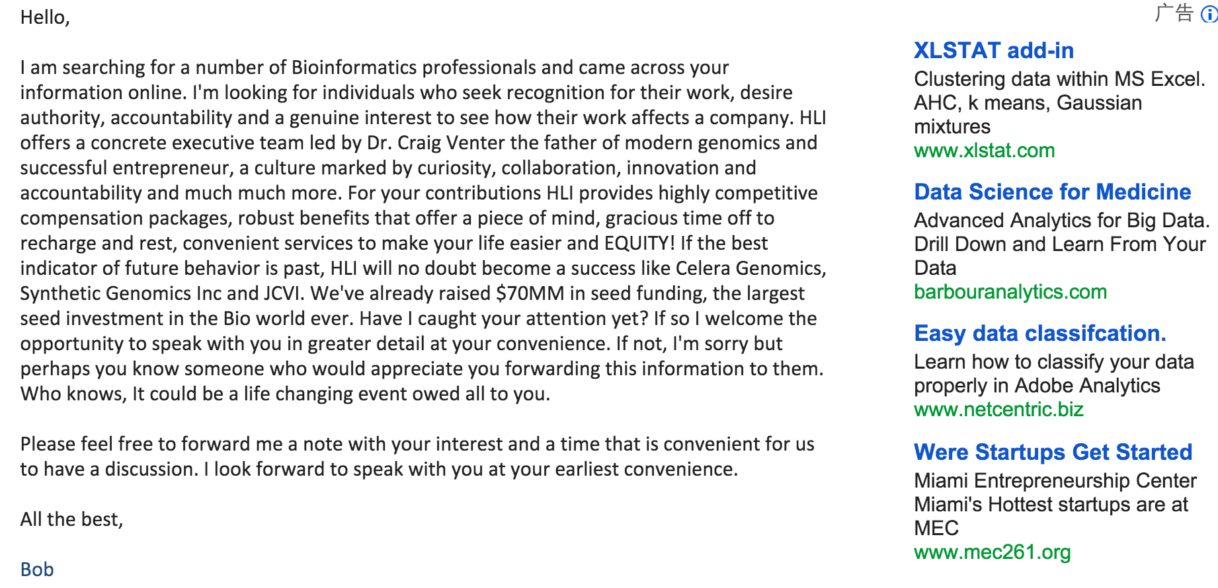
Text analysis in practice
Ads related to the content of this email

Slide 25

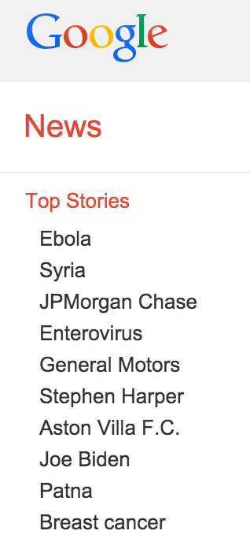
Text analysis in practice
Top events of the day

Slide 26
Text analysis in theory
Text classification:
Given a set of unlabeled articles and a trained model, find out the labels of these articles.
Topic modeling:
Give a set of unlabeled articles, find out a set of distinct topics and figure out the related topics of each article.

Slide 27
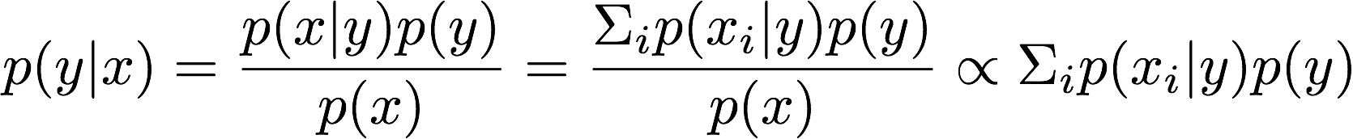
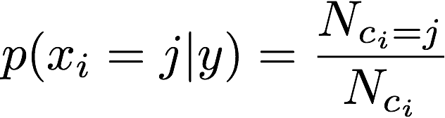
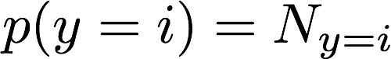
Text classification
Feature extraction: Bag of word
unigram, 2-gram, 3-gram
Naïve Bayes: (Assume features are conditional independent)
Given a set of features x, estimate the probability that the article belongs to each label.
Probability estimation:

Slide 28
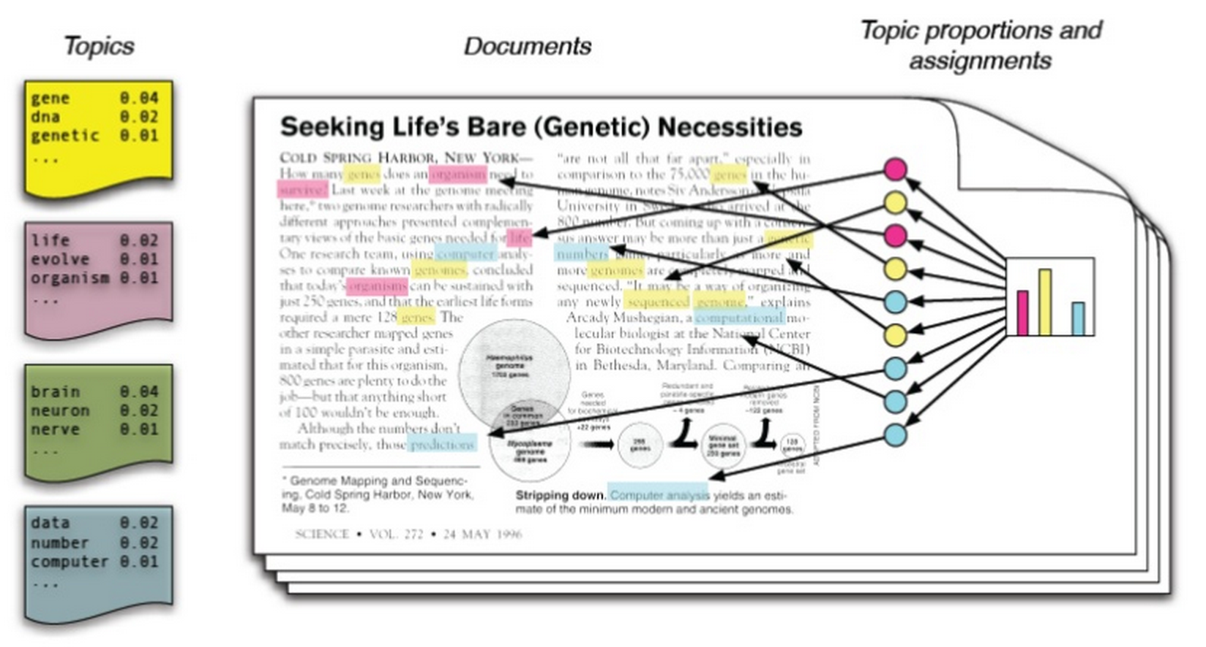
Topic modeling
Each article is considered as a mixture of topics, each word is generated according to a topic.
Copy from Umass CS

Slide 29
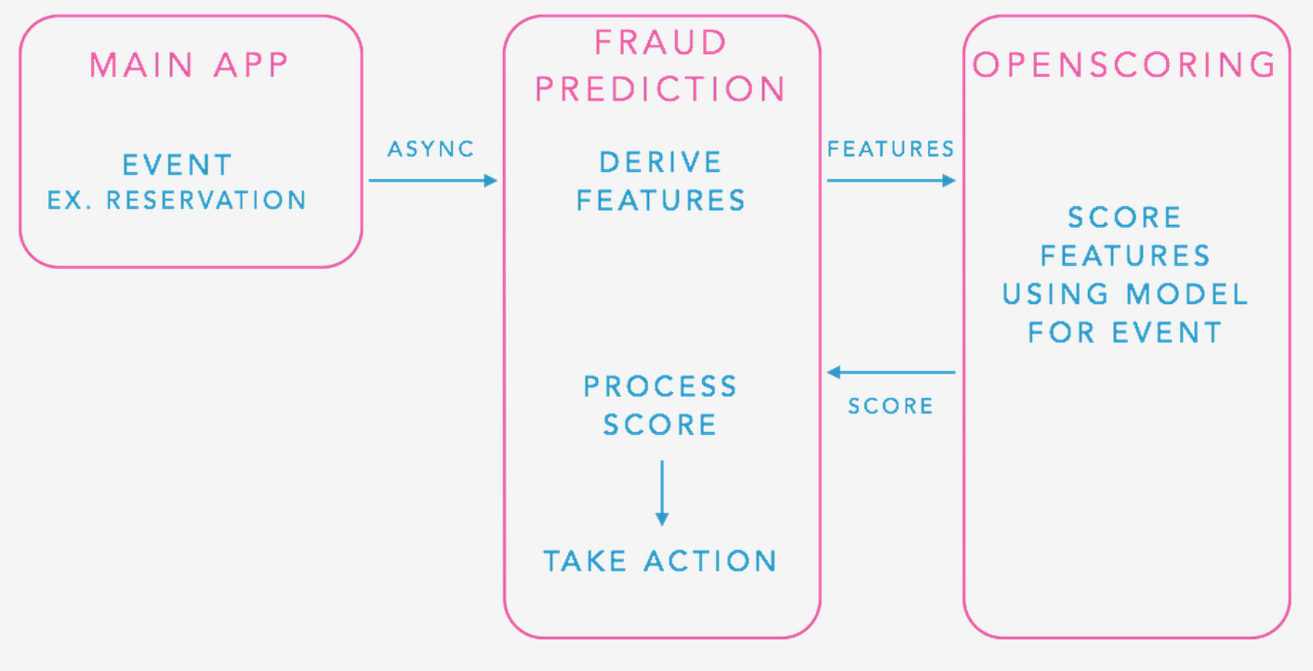
Anomaly detection in practice
Airbnb reservation anomaly detection

Slide 30
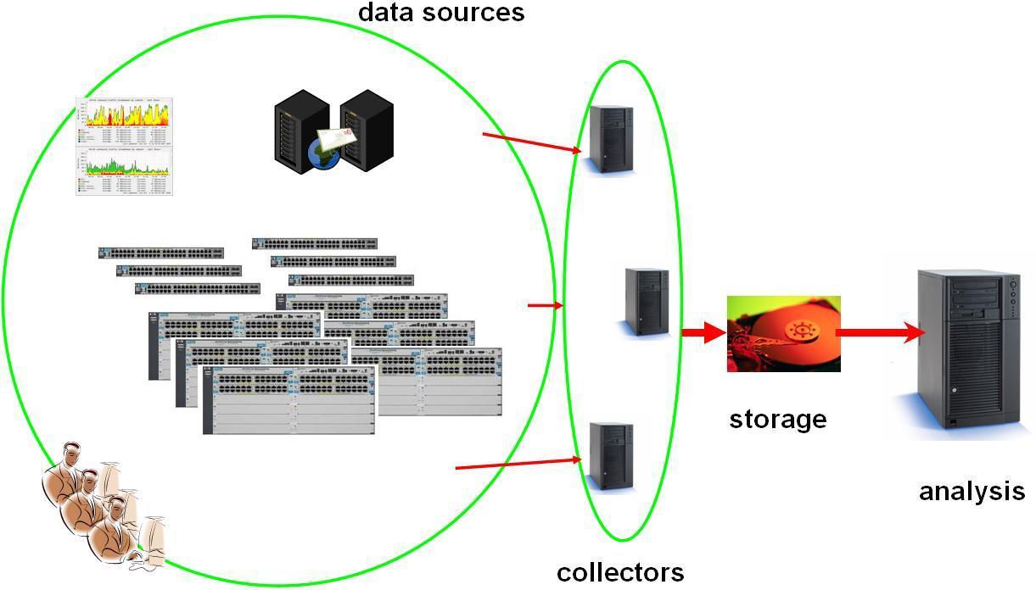
Anomaly detection in practice
System anomaly detection

Slide 31
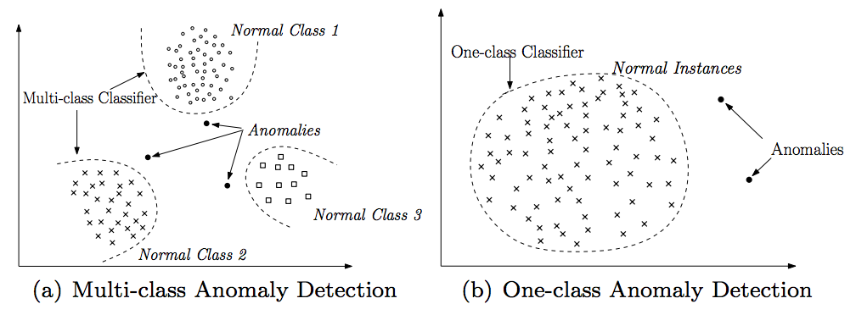
Anomaly detection in theory
Classification based: normal or abnormal?
Clustering based:
Time series anomaly:
Collective anomaly
Contextual anomaly

Slide 32
Conclusion
Academic & industry has different focus on KDD.
Academic cares about beauty while industry cares about practical
Academic more cares about the quality while industry more cares about the quantity

